Slide 1
WELCOME Getting Better All the Time

Slide 2
Center for Teaching and Learning (CTL)

Slide 3
AGENDA
Welcome and Introductions
Professor Marilyn Pelosi – Director, Center for Teaching and Learning
“The House of Cards”
Co Presented by:
Professor Rob Gettens – College of Engineering
Professor Harlan Spotts – College of Business
With Assistance from:
Professor Jennifer Mallory – College of Engineering
Professor Liang Niestemski – College of Arts and Sciences
3) Upcoming Events Sponsored by the Center for Teaching and Learning

Slide 4
The House of Cards

Slide 5
The House of Cards
Developed by
Don Carpenter
Presented by
Lanny Spotts
Rob Gettens
Jennifer Mallory
Liang Niestemski

Slide 6
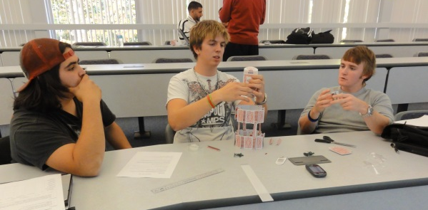
The house of cards
A customer focused design challenge
CHALLENGE FRAMEWORK

Slide 7
Time To Build!!!!!!!!

Slide 8
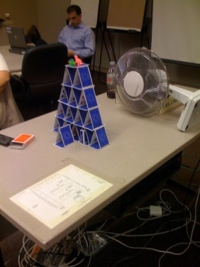
Time To Test!!!!!!!!

Slide 9
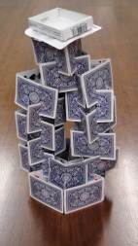
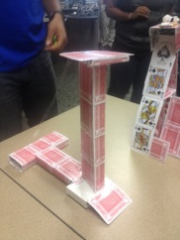
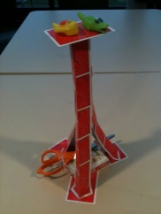
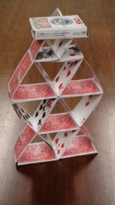
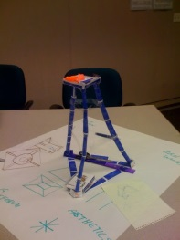
Sample Towers

Slide 10
Objectives
Critical Thinking
Customer Awareness
Prototyping
Learning from Failure

Slide 11
Alternative Discussion
Options:
Provide no design guidance...student developed
Provide guidance to some teams, but not all
Provide guidance document 5-10 minutes in
Openly discuss aesthetics goals & reveal new design components every 5 to 10 minutes

Slide 12
Assessment
Well received by students who can articulate the connection between the learning objectives and the exercise
Subsequent projects indicate students apply skills learned toward other problems

Slide 13
KEEN
Summer workshop:
Active Collaborative Learning (ACL)
Problem Based Learning (PBL)
Entrepreneurial Minded Learning (EML)
May 18-21st
$750 Stipend to attend
$1000 to Implement

Slide 14
UPCOMING EVENTS
Wellen Davison Seminar – MOVED TO April 6, 2015
December: Flipped Classroom HOW TO’s – Professors Wurm, Rosenman and Coulter
January: Voice & Diction Workshop – Ms. Barbara Moffat
February: Managing Classroom Discussions – Professors Peter Fairman and Jonathan Beagle
March: Managing Online Class Discussions – Professors Lynn Bowes-Sperry and Stacie Chappell
April : Reading Strategies to Help Your Students – Professor Deb Patterson

Slide 15
QUESTIONS? Thank you !

