Slide 1
Writing Assignments that Help Students Succeed

Slide 2
Principles of First-Year Writing Instruction
Development
Composition
Revision

Slide 3
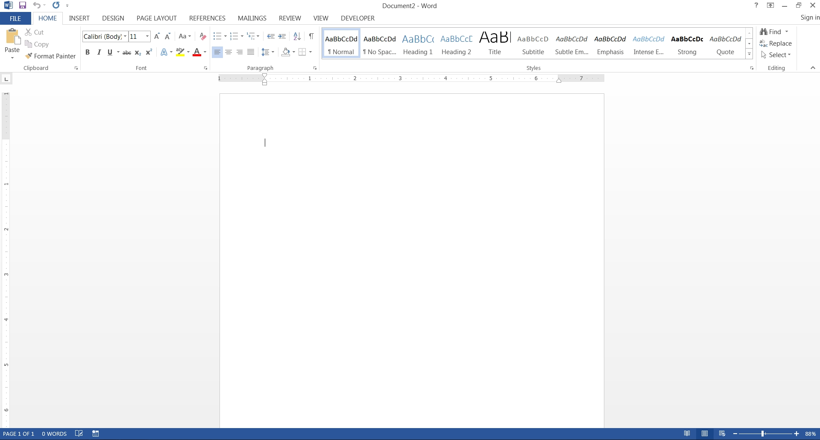
Composition

Slide 4
Principles of First-Year Writing Instruction
Development
Composition
Revision

Slide 5
Principles of First-Year Writing Instruction
Development
Composition
Revision
A goal is to make the work of composition a distinct step in a writing project – one that follows meaningful, disciplined work to develop the ideas and resources needed to complete the project.

Slide 6
Development
Development/Composition
Revision
Often the framework of writing assignments that are taking writing seriously focus on these steps...

Slide 7
Essay 2 Assignment
Development
Development/Composition
Revision
In a standard sequence, an assignment is given out and then between assignment and due date, students take on development and composition as they see fit.
And then revision follows to provide feedback and an opportunity to refine the student’ work.

Slide 8
Development
Development/Composition
Revision
Revision is optional, but development is going to happen.
So, on one hand, you might say that it doesn’t need to be assigned per se.

Slide 9
Development
Development/Composition
Revision
But if development happens at the same time as composition it won’t be very good.
Plus, we’ve missed a chance to teach students how to do the development required for the assignment.

Slide 10
Principles of First-Year Writing Instruction
Development
Composition
Revision
And in more cases than we might realize, students do need to learn somethings about how to do development....
And many problems that show up in essays are traceable back to problems in development.

Slide 11
Principles of First-Year Writing Instruction
Development
Composition
Revision
For instance, based on the testing of incoming students, and reflection on our experience in English 132, it became clear that we need to support students’ critical reading skills.
If a student doesn’t have a working understanding of course readings, no amount of revision is going to fix that essay.

Slide 12
Principles of First-Year Writing Instruction
Essay 2 Proposal Assignment
Essay 2 Prep Assignment
In-class Work with Essay 2 Prep
Development
Composition
Revision
Often this can mean identifying parts of writing that we – as more experienced writers – forget are discrete steps and skill. Things like:
identifying and summarize passages that will be relevant to the essay
which requires that the goals and thesis of the essay are already in place
understand the logical relationship between elements of the text

Slide 13
Principles of First-Year Writing Instruction
The Searchers / Building on Sources
Development
Composition
Revision
Similarly, the example of the two-paragraph assignment that asks students to cite a key point of a source, and then add a complementary reference to another is an example of how we can help students understand the identification and organization of ideas appropriate to the writing task.

Slide 14
Principles of First-Year Writing Instruction
Development
Composition
Revision
These are the steps that students will take to complete an effective writing project – but it is also a way for us to break down the elements of the writing task that we are trying to teach them.

