Slide 1
What Can We Learn from our 2016 NSSE Results?
Josephine Rodriguez
Lisa Hansen
Center for Teaching and Learning
March 28, 2017

Slide 2
Presentation Overview
What is NSSE?
A Look at WNE’s NSSE Data
Our NSSE 2016 Snapshot
How Can We Use NSSE Data?
Questions & Discussion

Slide 3
What is NSSE?
Measuring Student Engagement

Slide 4
Goals of NSSE Project
Focus conversations on undergraduate quality
Enhance institutional practice and improvement initiatives
Provide systematic national data on “effective educational practices”
Allows comparative activity with peer institutions
Notes:
Started in 2000
75% of our 32 peer comparison “like” institutions use NSSE
Historically, 1600 undergraduate institutions have participated in NSSE
In 2016, there were 512 institutions that participated.

Slide 5
NSSE Survey Content
Engagement in meaningful
academic experiences
Student learning
& development
Engagement in High-Impact Practices
Student reactions
to college
Student background
information
Notes:
The NSSE survey asks students to report the frequency with which they engage in activities that represent effective educational practice. Students also record their perceptions of the college environment associated with achievement, satisfaction, and persistence. Then, students estimate their educational and personal growth since starting college. Finally, students provide information about their background, including age, gender, race or ethnicity, living situation, educational status, and major field.

Slide 6
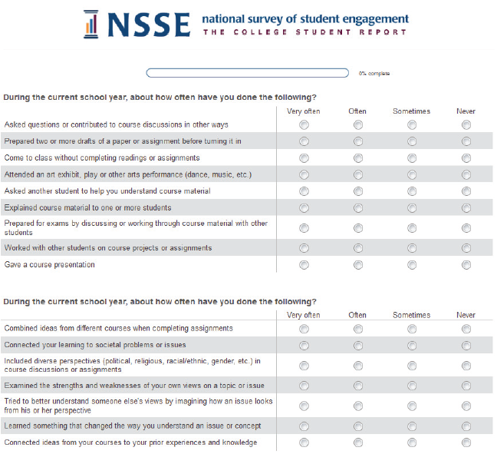
Survey Administration
Administered to first-year students & seniors in the Spring
Multiple follow-ups to increase response rates
Response Rates
 | WNE | NSSE National
First Year (n = 204) | 29% | 22%
Seniors (n = 235) | 36% | 24%
WNE has participated approximately once every 3-4 years (’02, ’05, ’09, ’12, ’16)
Notes:
First year: n = 204 (requested 700)
Seniors: n = 235 (requested 651)
The Center for Survey Research at Indiana University helps NSSE administer the survey in the field. See: csr.indiana.edu for more information.
NSSE survey design:
Relatively short survey
Items directly related to college outcomes
Administered to first-year and senior students at 4-year institutions
Administered directly by a credible third-party survey organization

Slide 7
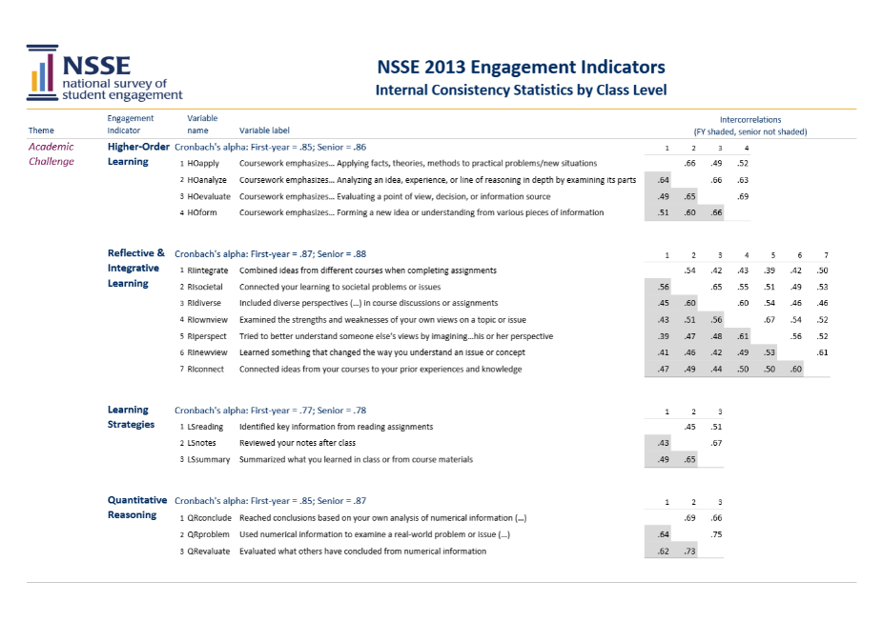
A Commitment to Data Quality
NSSE’s Psychometric Portfolio presents evidence of validity, reliability, and other indicators of data quality. It serves higher education leaders, researchers, and professionals who use NSSE.
See the Psychometric Portfolio
nsse.indiana.edu/html/psychometric_portfolio.cfm

Slide 8
A Look at WNE’s NSSE Data
Our Strengths and Weaknesses

Slide 9
Results on Some Individual Questions First Year Students
In random order…
Participated in a learning community or some other formal program where groups of students take two or more classes together (HIP)
Reached conclusions based on your own analysis of numerical information (numbers, graphs, statistics, etc.) (QR)
Quality of interactions with student services staff (career services, student activities, housing, etc.) (QI)
Included diverse perspectives (political, religious, racial/ethnic, gender, etc.) in course discussions or assignments (RI)
Institution emphasis on attending events that address important social/economic/political issues (SE)
Quality of interactions with faculty (QI)
Notes:
9

Slide 10
First Year Students
Strengths
Reached conclusions based on your own analysis of numerical information (numbers, graphs, statistics, etc.) (QR)
Quality of interactions with faculty (QI)
Quality of interactions with student services staff (career services, student activities, housing, etc.) (QI)
Areas for Improvement
Participated in a learning community or some other formal program where groups of students take two or more classes together (HIP)
Institution emphasis on attending events that address important social/economic/political issues (SE)
Included diverse perspectives (political, religious, racial/ethnic, gender, etc.) in course discussions or assignments (RI)
Notes:
10

Slide 11
Results on Some Individual Questions Seniors
In random order…
Participated in an internship, co-op, field experience, student teaching, clinical placement (HIP)
Frequency of discussions with people of a race or ethnicity other than your own (DD)
Spent more than 10 hours per week on assigned reading
Assigned more than 50 pages of writing
Discussed course topics, ideas, or concepts with a faculty member outside of class (SF)
Identified key information from reading assignments (LS)
Notes:
11

Slide 12
Seniors
Strengths
Participated in an internship, co-op, field experience, student teaching, clinical placement (HIP)
Discussed course topics, ideas, or concepts with a faculty member outside of class (SF)
Assigned more than 50 pages of writing
Areas for Improvement
Spent more than 10 hours per week on assigned reading
Frequency of discussions with people of a race or ethnicity other than your own (DD)
Identified key information from reading assignments (LS)
Notes:
12

Slide 13
NSSE High Impact Practices
Learning Community
Service Learning
Research with Faculty
Internship or Field Experience
Study Abroad
Culminating Senior Experience
Notes:
13

Slide 14
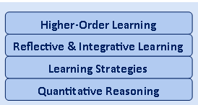
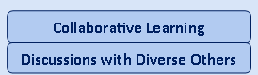
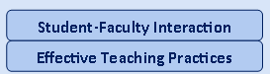
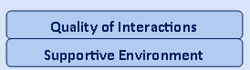
NSSE Engagement Indicators
Meaningful Academic Engagement Themes
Engagement Indicators
Academic Challenge
Learning with Peers
Experiences with Faculty
Student – Faculty Interaction
Campus Environment
Notes:
14

Slide 15
Engagement Indicators Worksheet
Prediction: for the engagement indicators, predict whether each is a strength, weakness or average for WNE (compared to the national average).
KEY: + strength
= about average
- needs improvement
Preference: choose the 3 or 4 engagement indicators that you would like to see as a strength for WNE.
KEY: + strength
On the index card, write the 3 or 4 engagement indicators that you chose for the Preference column.
Notes:
15

Slide 16
Our 2016 NSSE Snapshot

Slide 17
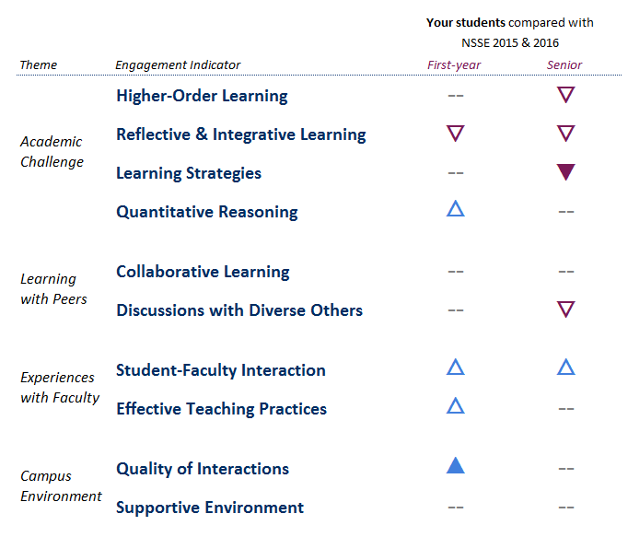
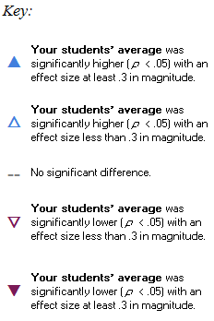
WNE Engagement Indicators comparison to NSSE National
Notes:
Encourage observations from faculty attending workshop.

Slide 18
WNE First Year Retention Rates

Slide 19
WNE Diversity Rates
Year | Domestic Minority Students | International Students | Diversity Total | Fulltime Undergraduate Population | Diversity Rate
2011 | 375 | 15 | 390 | 2472 | 15.8%
2012 | 394 | 30 | 424 | 2520 | 16.8%
2013 | 416 | 52 | 468 | 2498 | 18.7%
2014 | 471 | 74 | 545 | 2576 | 21.2%
2015 | 475 | 89 | 564 | 2578 | 21.8%
2016 | 486 | 93 | 579 | 2580 | 22.4%

Slide 20
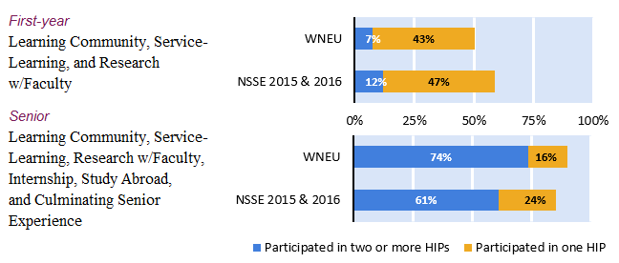
WNE High Impact Practice Participation comparison to NSSE National

Slide 21
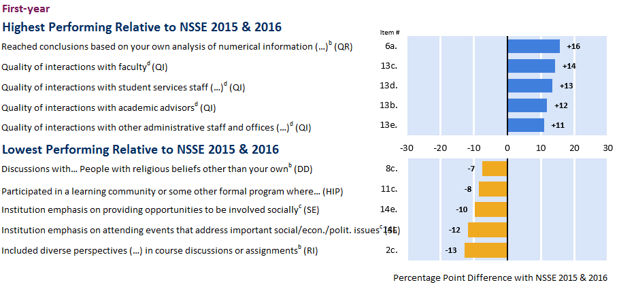
WNE Highest and Lowest Performing Items compared to NSSE National
First Year Students

Slide 22
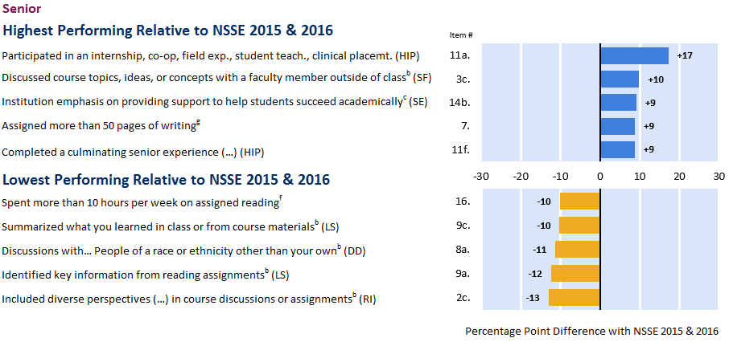
WNE Highest and Lowest Performing Items compared to NSSE National
Seniors

Slide 23
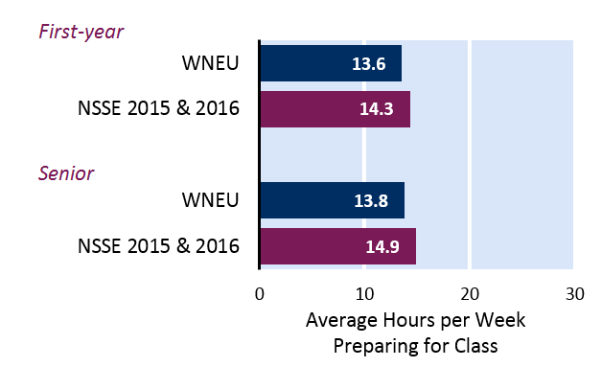
Time Spent Preparing for Class
About how many hours do you spend in a typical 7-day week preparing for class?

Slide 24
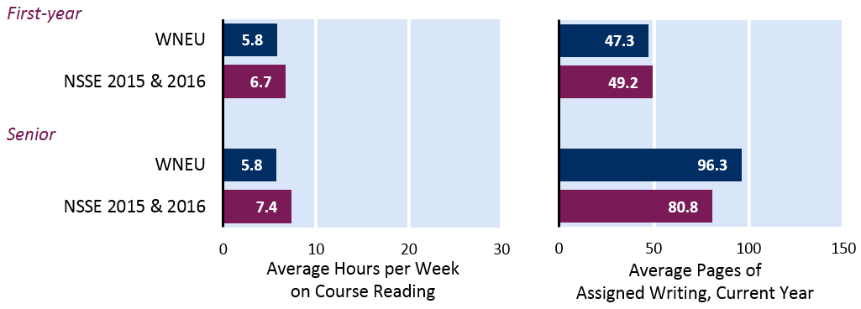
Reading and Writing
A summary of the number of hours students spent reading for their courses and the average number of pages of assigned writing.

Slide 25
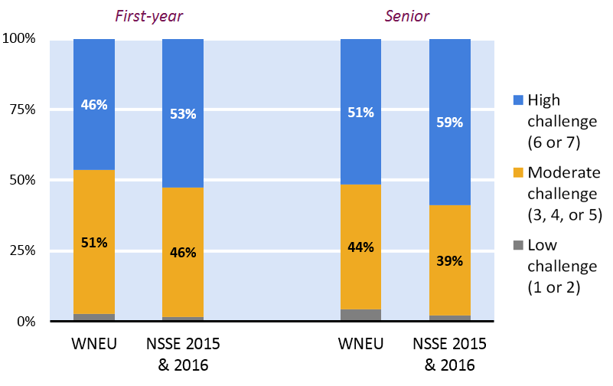
Challenging Students to Do Their Best Work
To what extent did students’ courses challenge them to do their best work?

Slide 26
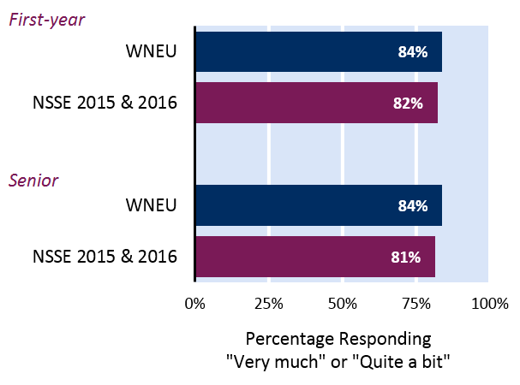
Academic Emphasis
How much did students say WNE emphasizes spending significant time studying and on academic work?

Slide 27
How Can We Use NSSE Data?

Slide 28
Internal Campus Uses
Gauge status of campus priorities
Examine changes in student engagement between first and senior years
Assess campus progress over time
Encourage dialogue about good practice
Link with other data to test hypotheses, evaluate programs
Improve curricula, instruction, services
Learning Communities
Enrollment Management
1ST Year and Senior Experience
Institutional Research
Academic Affairs
Institutional
Improvement
Student Affairs
Learning Assessment
Peer Comparison
Faculty Development
Academic Advising
Notes:
Institutions often use several approaches to share their results. It is usually most effective to use a combination of dissemination techniques.
Targeting specific audiences to share results can facilitate focused dialogue about implications of the findings for policy and practice. For example:
Present findings to a faculty advisory committee
Plan a half day retreat for student affairs staff
Institutions can share results campus-wide by posting summaries of important findings or by inviting colleagues to review the full report online. For example:
Create individual reports for the deans of each college to present to their faculty
Share findings in announcements at faculty and staff meetings
Post results on websites and share findings through newsletters

Slide 29
Example of Data Use: Increasing Academic Challenge
FAYETTEVILLE STATE UNIVERSITY
Finding:
Writing and time spent preparing for class were lower than desired.
Action:
Provided NSSE data to department chairs so that areas of potential improvement could be identified. The institution also increased investment in learning communities and capstone courses to strengthen writing across the curriculum and class preparation.
Notes:
This slide presents an example of how a NSSE-participating institution is already using its NSSE, BCSSE, and or FSSE data.
NSSE recommends creating your own slides and action items for your college or university.

Slide 30
Example of Data Use: Enriching and High-Impact Practices
JACKSONVILLE STATE UNIVERSITY
Finding:
Student reported engagement in service-learning and other high-impact practices were not as high as desired.
Action:
The Office of Leadership and Service was created to coordinate service-learning, promote service learning, and provide support to faculty interested in developing service-learning courses.

Slide 31
Questions & Discussion

Slide 32
Your Observations Engagement Indicators and the NSSE Snapshot
WNE faculty and staff at the workshop observed:
For first year students, 4 of the 10 Engagement Indicators were above the national average, and only 1 of the 10 was below. We seem to be doing a pretty good job with our first year students.
For seniors, 4 of the 10 Engagement Indicators were below the national average, and only 1 of the 10 was above. There is certainly room for improvement with our seniors.
Most of our weaknesses are in Academic Challenge.
Reflective and Integrative Learning was below the national average for both freshman and seniors.
Notes:
To be filled in after the workshop

Slide 33
Your Observations Engagement Indicators and the NSSE Snapshot
WNE faculty and staff at the workshop observed:
Student-Faculty Interaction was above the national average for both first year students and seniors, which reinforces what many of us promote about WNE at Open Houses – we enjoy working with our students and getting to know them.
Collaborative Learning was average, which is lower than expected, based on the fact that there is an emphasis on collaborative learning in Business and Engineering.
Although Learning Strategies was below the national average for seniors, this might be explained by the fact that there are more project-based courses for seniors in certain majors and fewer lecture-based courses requiring use of the study skills listed under Learning Strategies.
Notes:
To be filled in after the workshop

Slide 34
Your Observations Engagement Indicators and the NSSE Snapshot
WNE faculty and staff at the workshop observed:
Discussions with Diverse Others was average for first year students, but below average for seniors.
Do first year students have a different view on the amount of diversity than seniors?
Is there a retention issue for diversity students over the four years?
Students reported having to write a lot, but didn’t have to read a lot.
The average number of hours preparing for classes is low (less than 14 hours of preparation per week). For a student taking a 5-course load, this is about 2.8 hours per course in a typical week.
Notes:
To be filled in after the workshop

Slide 35
Possible Action Items Engagement Indicators and the NSSE Snapshot
WNE faculty and staff at the workshop suggested:
As faculty, we should do something to improve Reflective and Integrative Learning, both horizontally (across first year courses) and vertically (through senior courses).
We should consider how the NSSE data might be useful in guiding our discussions about General University Requirements.
How might we promote a greater focus on the Engagement Indicators in our courses? Maybe we could encourage incorporating course development to employ these strategies through Faculty Development Grants?
Notes:
To be filled in after the workshop

Slide 36
WNE Faculty Priorities From the NSSE Engagement Indicators
Priorities indicated by WNE faculty and staff at the workshop

Slide 37
Resources
NSSE Website: http://nsse.indiana.edu/
Association of American Colleges and Universities: High Impact Practices Website: https://www.aacu.org/leap/hips
Banta, T. W., Pike, G. R. and Hansen, M. J. (2009), The use of engagement data in accreditation, planning, and assessment. New Directions for Institutional Research, 2009: 21–34.
Kinzie, J. and Pennipede, B. S. (2009), Converting engagement results into action. New Directions for Institutional Research, 2009: 83–96.
Kuh, George D. (2008). “High-impact educational practices: What they are, who has access to them, and why they matter.” AAC&U, Washington, D.C.

Slide 38
Contact Information
Josephine Rodriguez,
Director of Assessment
jrodigu@wne.edu
(413) 782-1692
Lisa Hansen,
Associate Coordinator of Assessment
lhansen@wne.edu
(413) 782-1763
.

