Slide 1
Priority Registration
Hints, Tip and Troubleshooting

Slide 2
Watch the Registration Video before Registration begins so you will be ready. https://www1.wne.edu/enrollment-services/registration.cfm

Slide 3
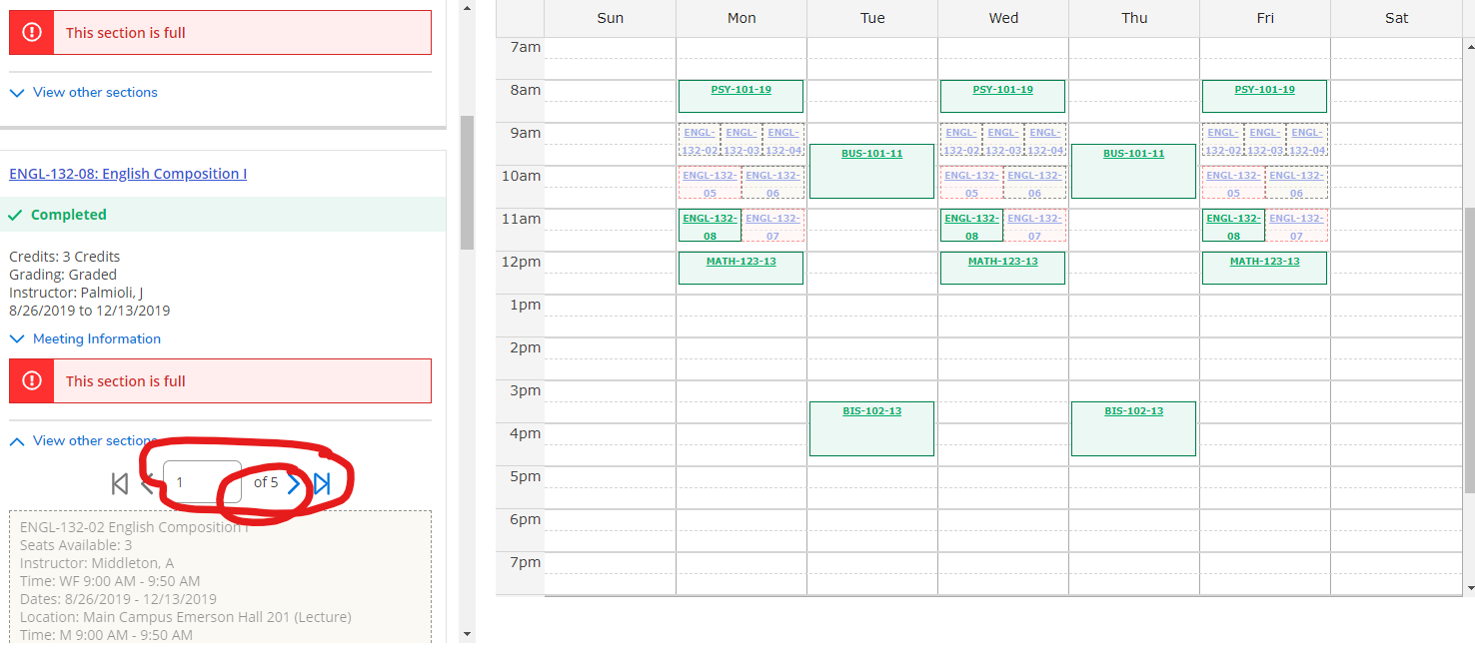
Courses can have multiple sections, please look past page 1 to see all offerings – You might see one that suites your needs!
MULTIPLE SECTION SEARCH

Slide 4
Work Closely with your Advisor
Make clear notes in the notes section of Self Service
Request Advisor to Review your Schedule
Have a back up plan
Courses may be closed

Slide 5
Registration dates and times
Register during your assigned time
Registration does not end!
Priority Registration gives current WNE students first shot at registration
Open Registration begins after Priority Registration for guest students to WNE
You can change your registration until the first day of classes

Slide 6
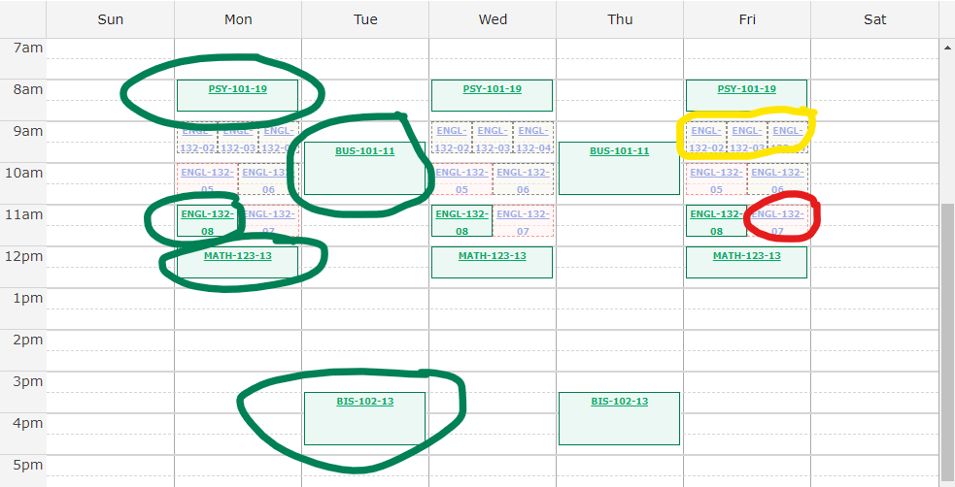
GREEN MEANS GOOD TO GO!
Green = Successfully Registered
Yellow = course section is available
Red = course section has a conflict or is closed, not available

Slide 7
What if something goes wrong?
Don’t panic! Registration does not end on your assigned date/time
Be sure that you have taken care of your messages in Self Service
Updated personal contact information
Taken care of Bursar Holds
Contact your Advisor for Assistance

